Slide 1



Data Engineering Track
DEPI Graduation Project
Customer Data Management Project
Under the Supervision of Eng: Shaimaa Daowd
October 22, 2024
Data Engineering Success Team

Slide 2


Team
Ali Mohamed
Abdelrahman Ali
Habiba Khaled
Bodour Mohamed
Menna-Tollah Abdelhaleem
Aya-Tollah Abdelhamed

Slide 3

Content
Description of the project.
Database:
ERD.
Mapping.
System Schema.
Stored Procedures.
Views.
Triggers.
Functions.
Data Warehouse:
Integration Service:
Fact & Dim Diagram.
Packages.

Slide 4
Content
Analysis Service:
Cube Structure.
Insights using SSAS.
Analysis with Python:
Line Charts.
Bar Charts.
Pie Charts.
Power BI:
Dashboards.
Machine Learning Models.

Slide 5

Description of the project

Slide 6
Description of the project
The customer data management project involved creating a comprehensive database to manage customer information, order details, product data, complaints, feedback, and returns. A data warehouse was created to integrate different metrics, enabling efficient analysis using fact tables and dimensions, with SSIS and SSAS used to create analytical cubes.
For analysis, Python was used to develop charts such as line charts, bar charts, and pie charts, facilitating insights into service levels, sales trends, and year-on-year comparison of the company’s performance. A Power BI dashboard was created to display certain charts and analyses of the company’s performance. Finally, a machine learning model was developed to enhance predictive capabilities regarding customer behavior and sales forecasts.

Slide 7
Database:
ERD.
Mapping.
System Schema.
Stored Procedures.
Views.

Slide 8
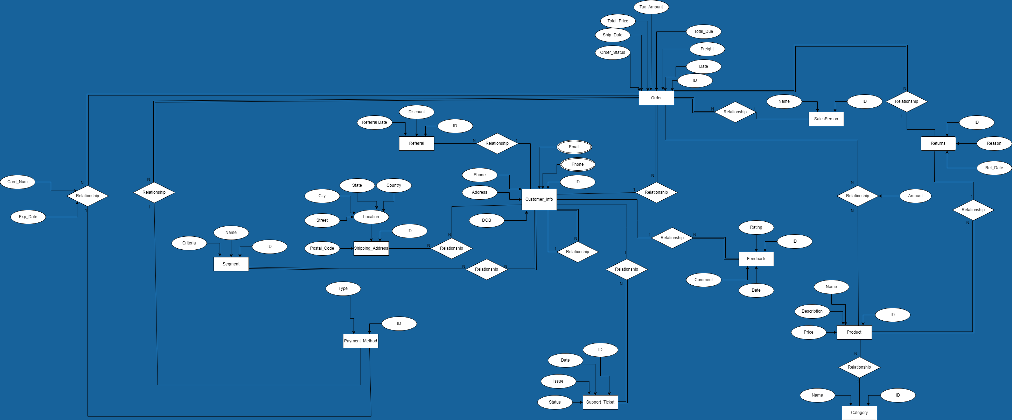
ERD

Slide 9
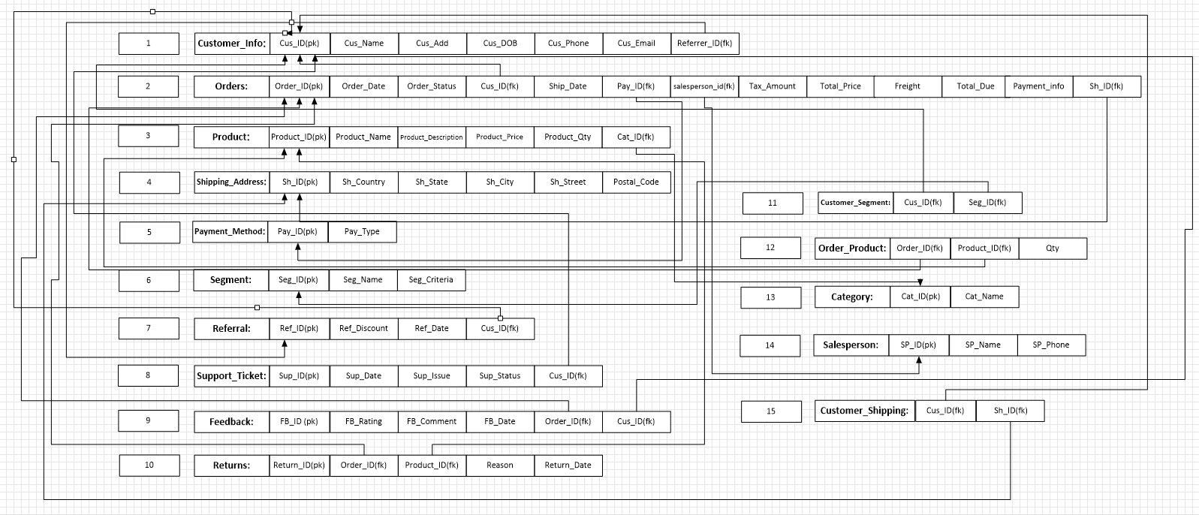
Mapping

Slide 10
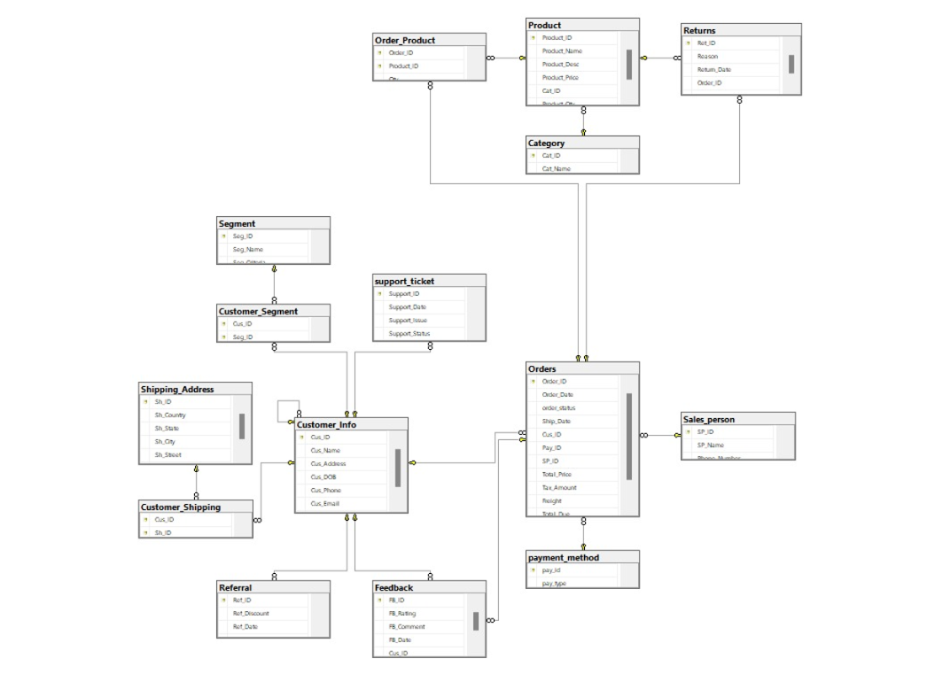
System Schema

Slide 11
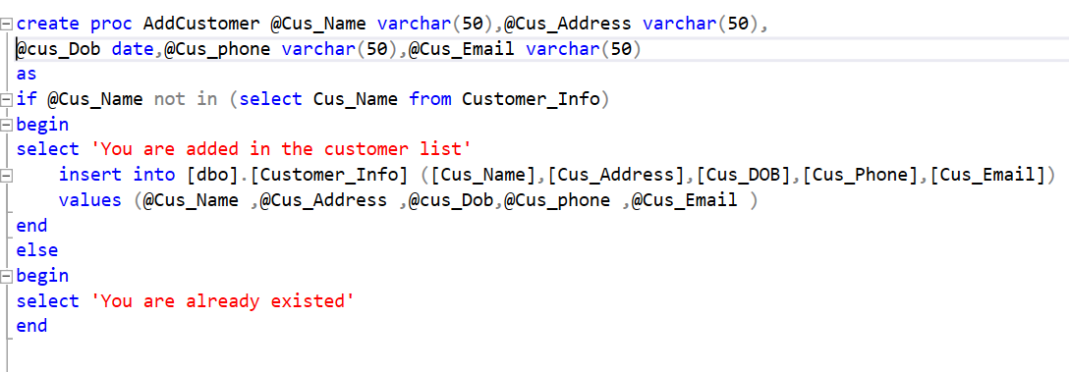
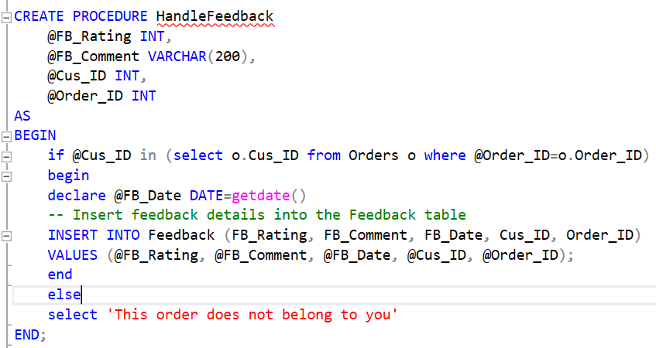
Stored Procedures
AddCustomer: adds customer to the system.
HandleFeedback: adds customers’ feedback to the system.

Slide 12
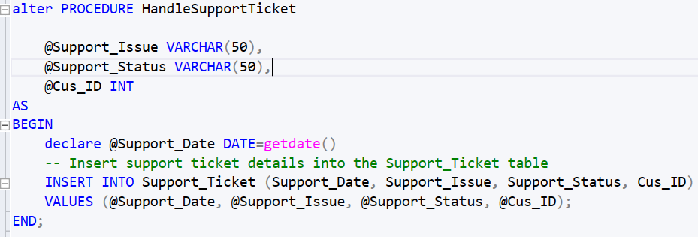
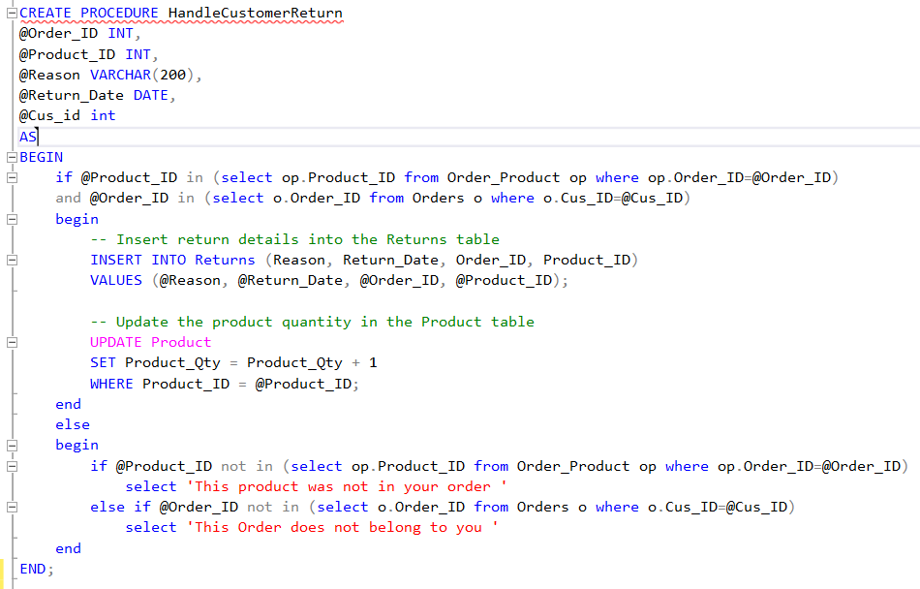
Stored Procedures
HandleSupportTicket: adds any complaints from customers.
HandleCustomerReturn: adds any returns made by the customer by adding the order number he made and also the product number within the order.

Slide 13
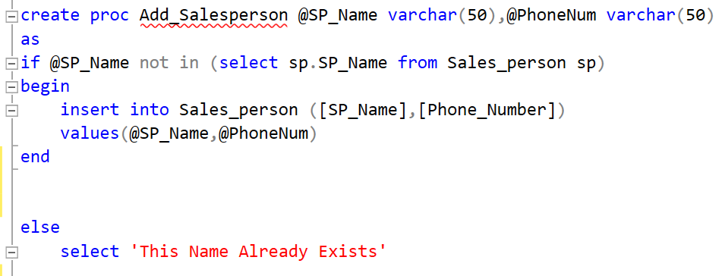
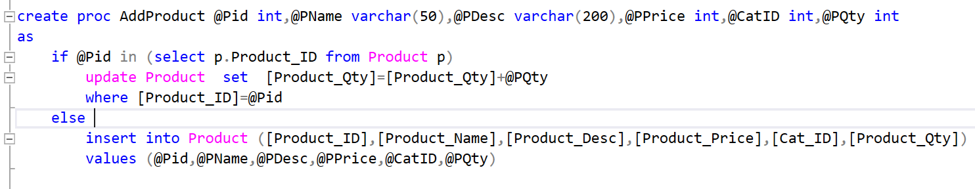
Stored Procedures
Add_Salesperson: adds a salesperson within the system, and this is only authorized for the manager.
AddProduct: adds a product to the system, and this is only authorized for the manager.

Slide 14
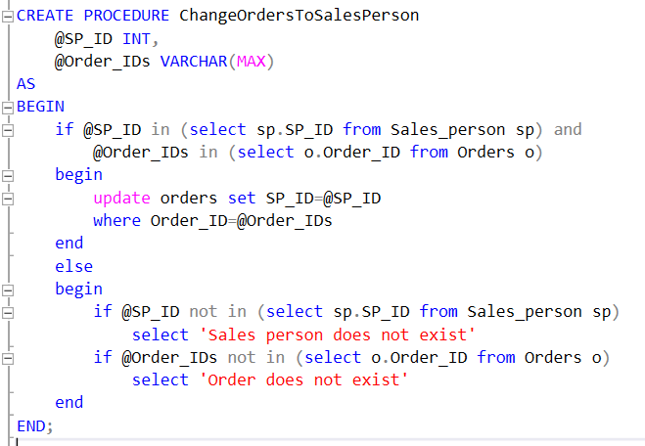
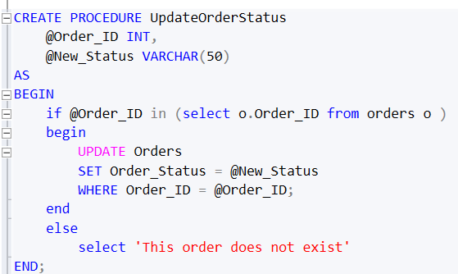
Stored Procedures
ChangeOrdersToSalesPerson: changes the order for a specific salesperson by enter salesperson ID and order ID, and this is only authorized for the manager.
UpdateOrderStatus: updates the status of a specific order if it is (Delivered, Pending, or Cancelled), and this is done within the system.

Slide 15
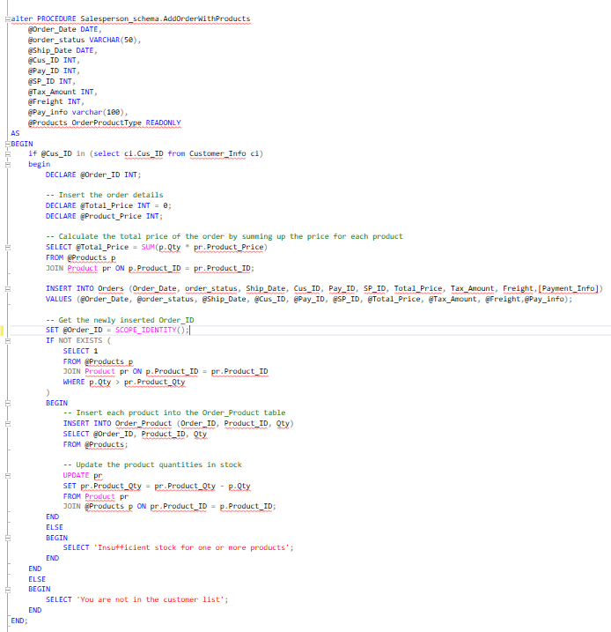
Stored Procedures
AddOrderWithProducts: the system adds a new order for a specific customer, and the customer ID is recorded, as well as the salesperson ID to whom the order will be delivered, as well as the total cost of the order.

Slide 16
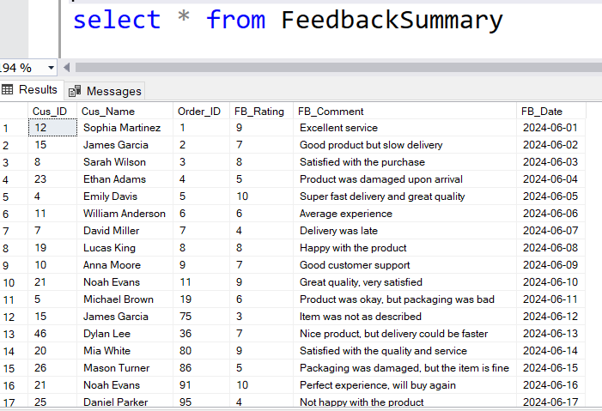
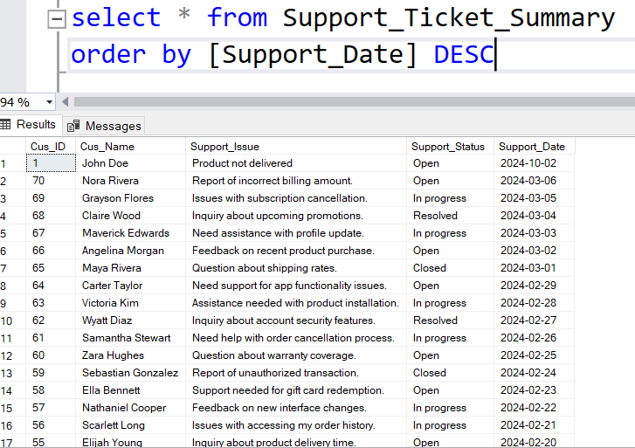
Views
FeedbackSummary: displays details of each customer's feedback on each order he made and the feedback date.
Support_Ticket_Summary: displays customers' complaints, complaints statuses (open, in progress, resolved), and the date of their complaints.

Slide 17
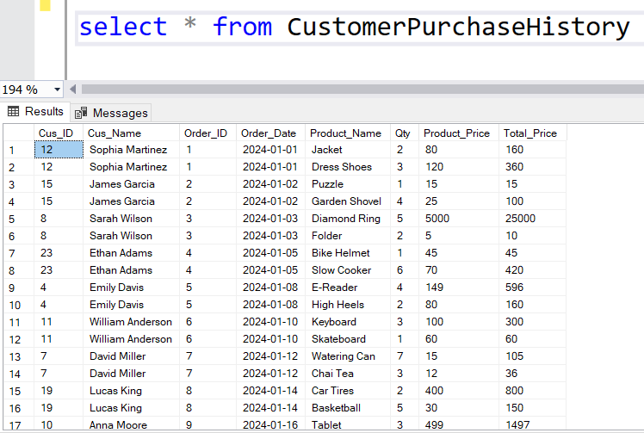
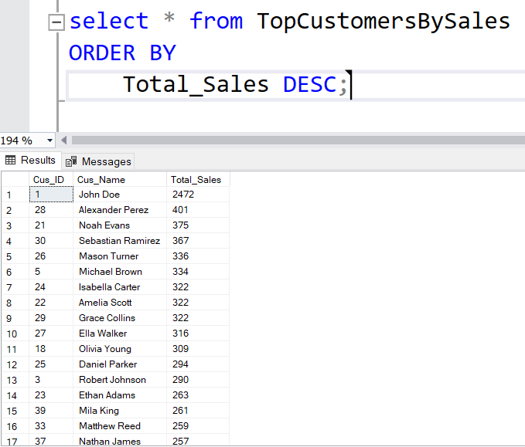
Views
CustomerPurchaseHistory: displays the details of each order (order date, the quantity of each product, and total price) that the customer made.
TopCustomersBySales: displays the most customers who purchased products, and we will need this to make statistics on the company’s sales.

Slide 18
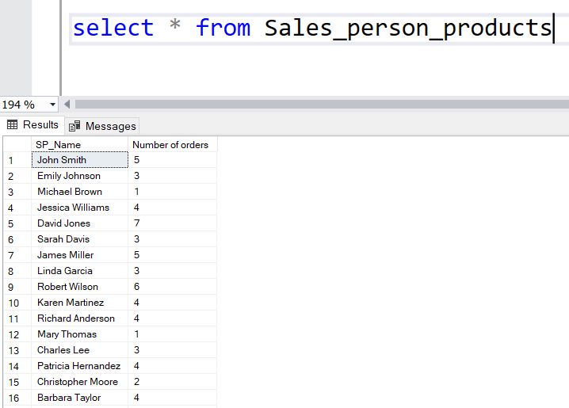
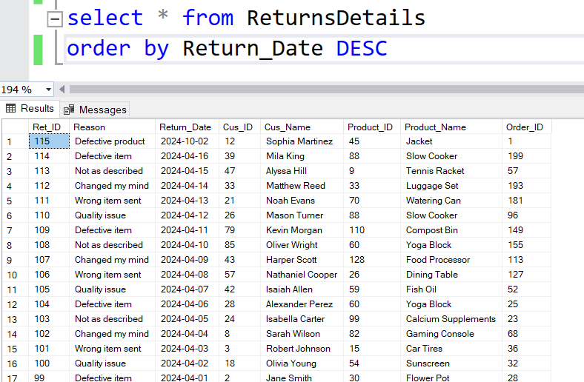
Views
Sales_person_products: displays how many orders each salesperson is responsible for.
ReturnsDetails: displays returns table in detail including (the reason for the return of the product, the return date, who the customer took the action on, and what product he returned in the order he made).

Slide 19
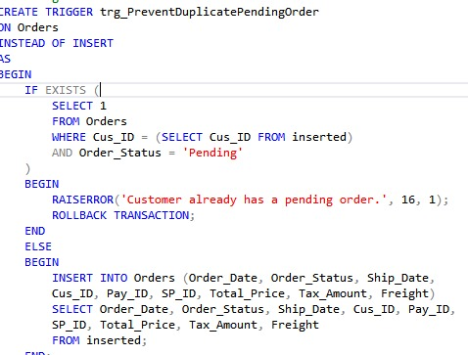
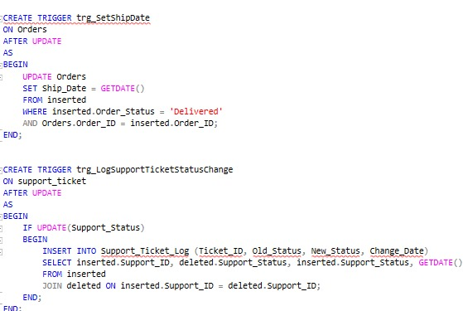
Triggers
1) trigger prevents a customer from placing more than one Pending order.
2) trigger automatically sets the Ship_Date when Order_Status is updated to 'Delivered'.

Slide 20
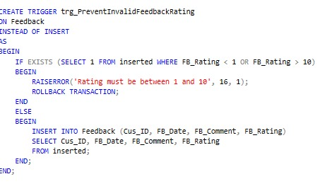
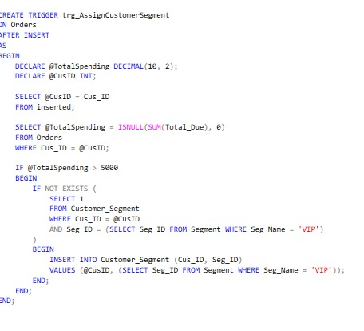
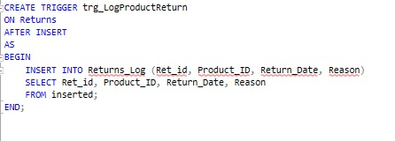
Triggers
3) trigger assigns a customer to the 'VIP' segment if their total spending exceeds $5000.
4) ensures that the rating in the Feedback table is between 1 and 5.
5) logs an entry into a Returns_Log table whenever a return is recorded.

Slide 21
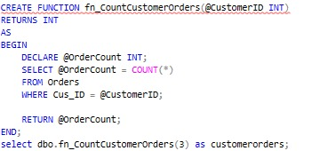
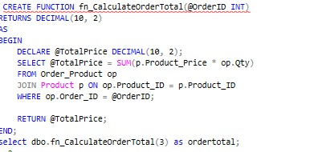
Functions
1) Calculate Order Total :calculate the total price for an order by summing the price of each product in the Order_Product table.
2) Count Customer Orders :returns the total number of orders a customer has placed.

Slide 22
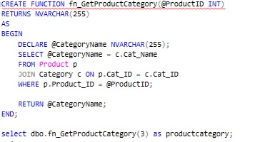
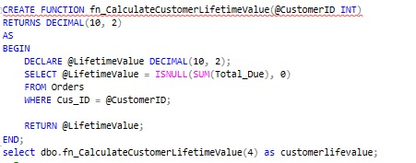
Functions
3) Get Product Category :returns the category name of a product.
4) Calculate Customer Lifetime Value (CLV) :calculates the total spending of a customer.

Slide 23
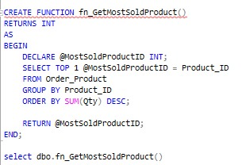
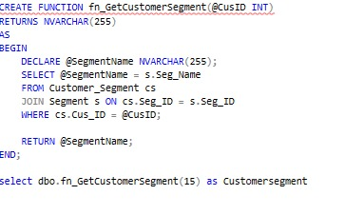
Functions
5) Get Most Sold Product :returns the Product_ID of the most sold product.
6) Get Customer Segment :returns the segment name of a customer.

Slide 24
Data Warehouse:
Integration Service:
Fact & Dim Diagram.
Packages.
Analysis Service:
Cube Structure.
Insights using SSAS.

Slide 25
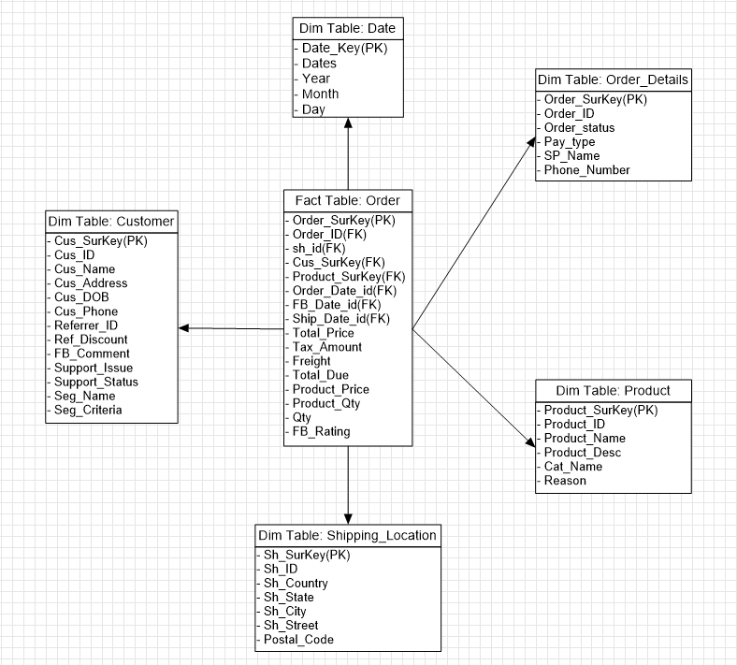
Integration Service
Fact & Dim Diagram

Slide 26
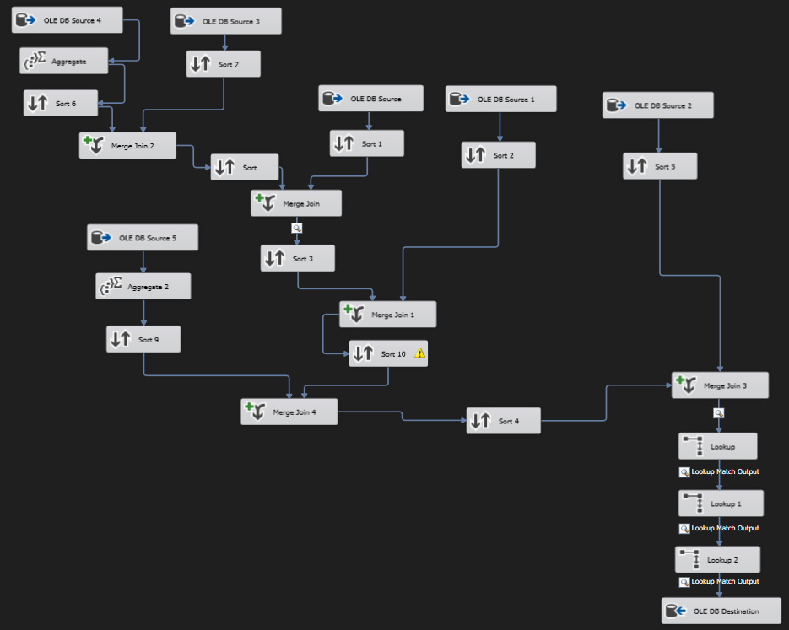
Integration Service
Fact_Order Package

Slide 27
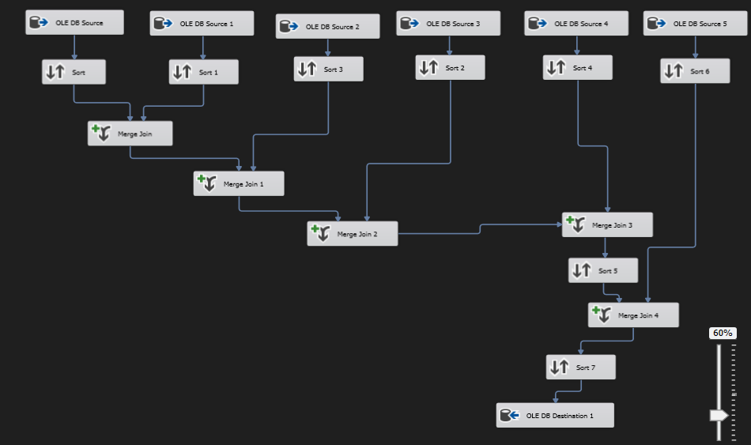
Integration Service
Customer_Dim Package

Slide 28
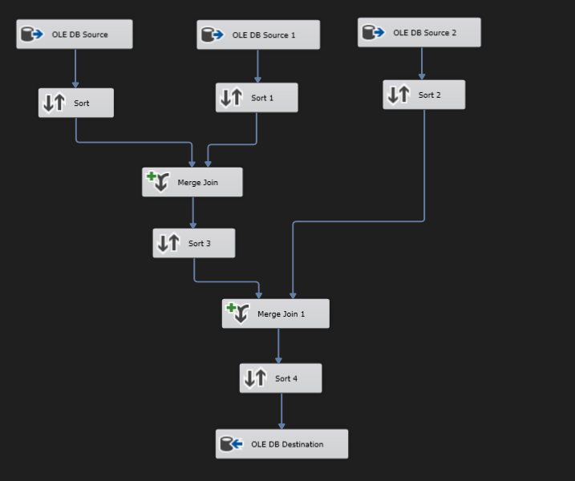
Integration Service
Order_Details_Dim Package

Slide 29
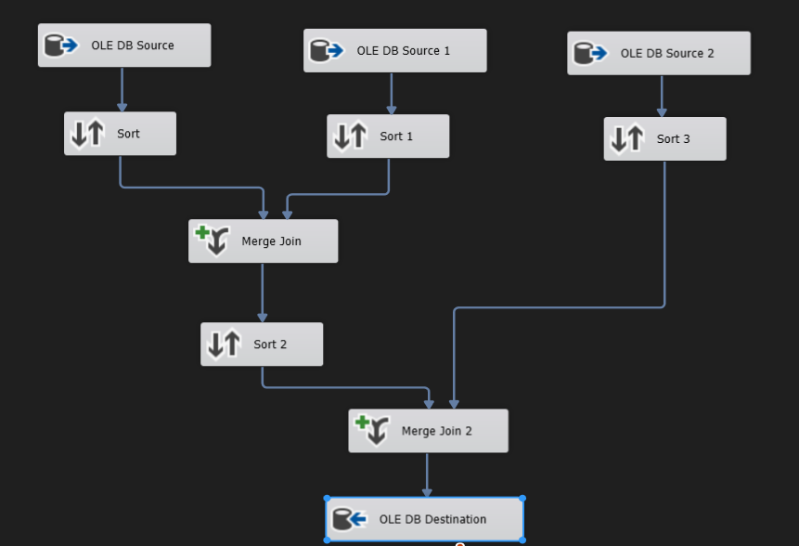
Integration Service
Product_Dim Package

Slide 30
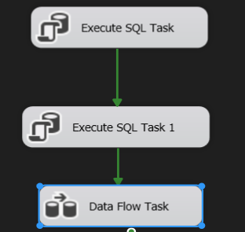
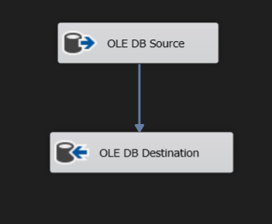
Integration Service
Shipping_Location_Dim Package

Slide 31
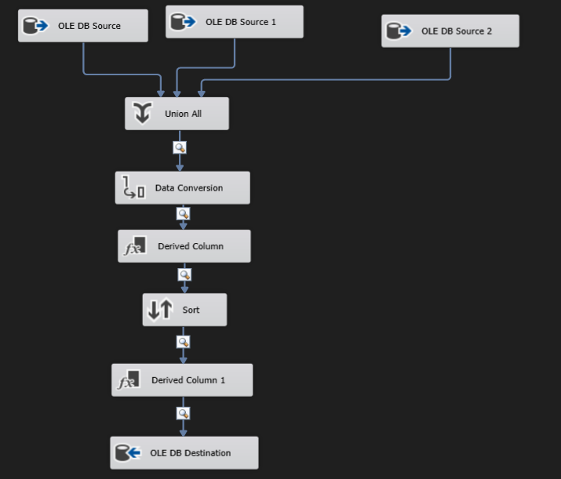
Integration Service
Date_Dim Package

Slide 32
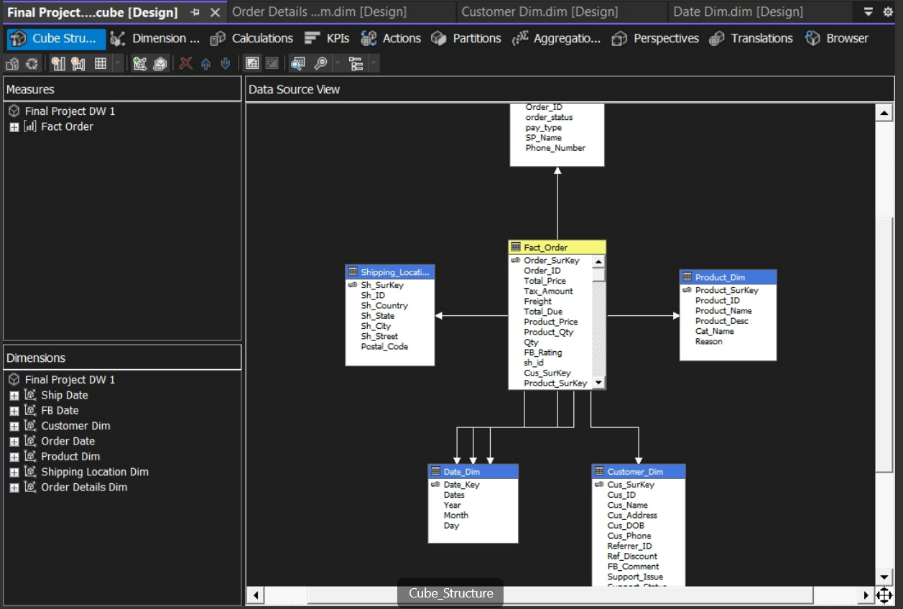
Analysis Service
Cube Structure

Slide 33
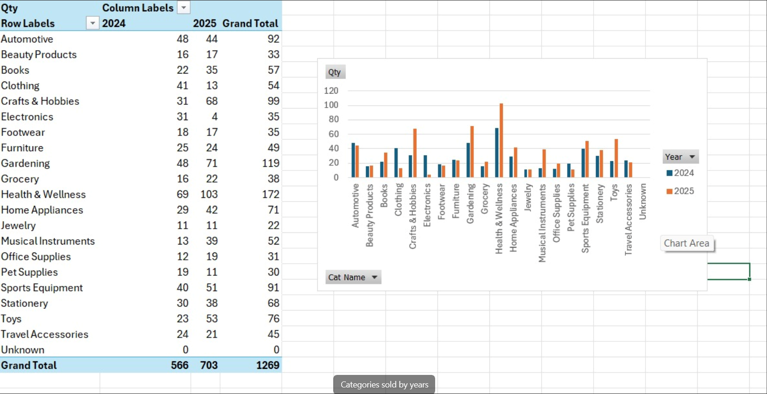
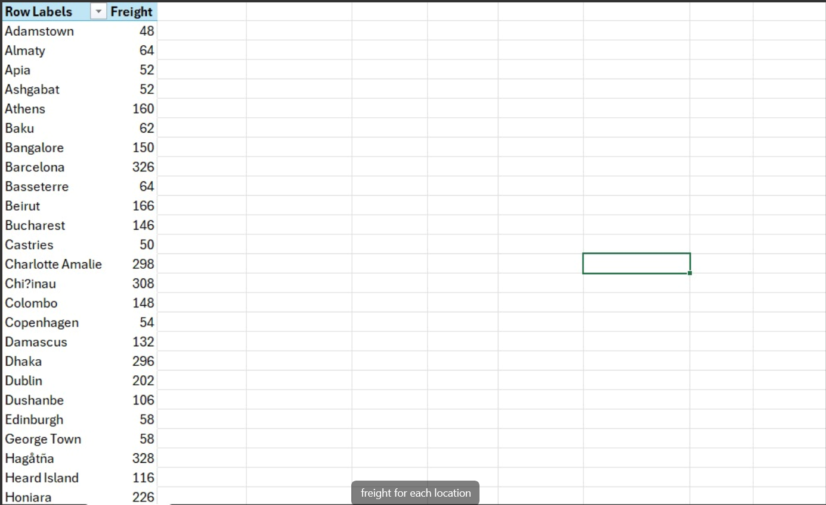
Analysis Service
Insights using SSAS
Categories sold by years.
Freight for each location.
Categories sold by years
Freight for each location

Slide 34
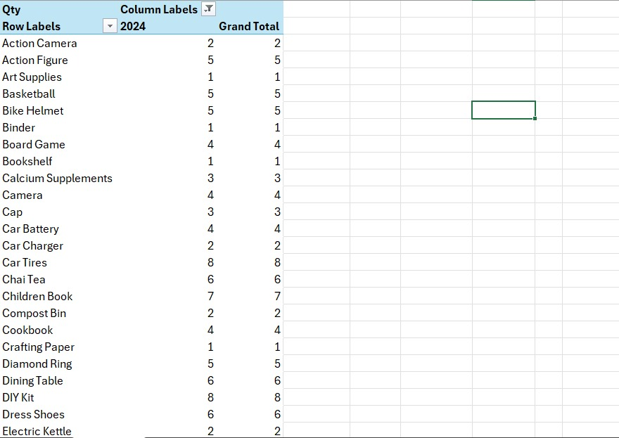
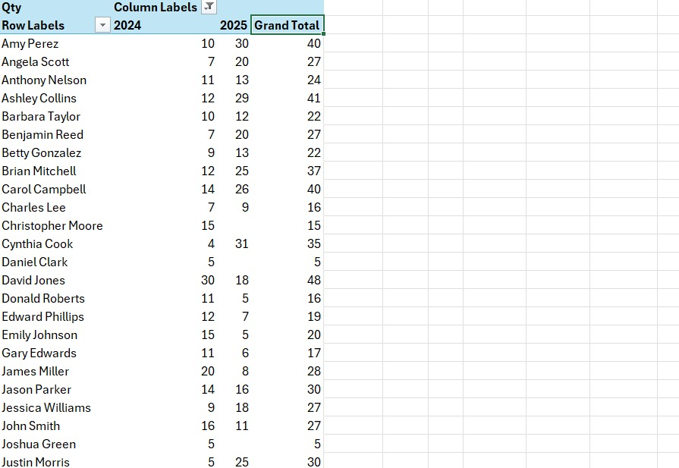
Analysis Service
Insights using SSAS
Sales for each product in 2024.
Sales by each sales person for each year.
Sales for each product in 2024
Sales by each sales person for each year

Slide 35
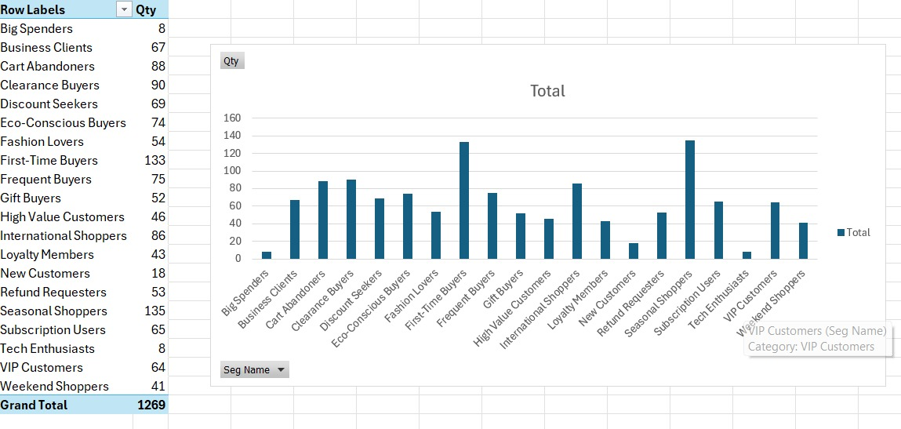
Analysis Service
Insights using SSAS
Sales by each segment.
Sales by each segment

Slide 36
Analysis with Python:
Line Charts.
Bar Charts.
Pie Charts.

Slide 37
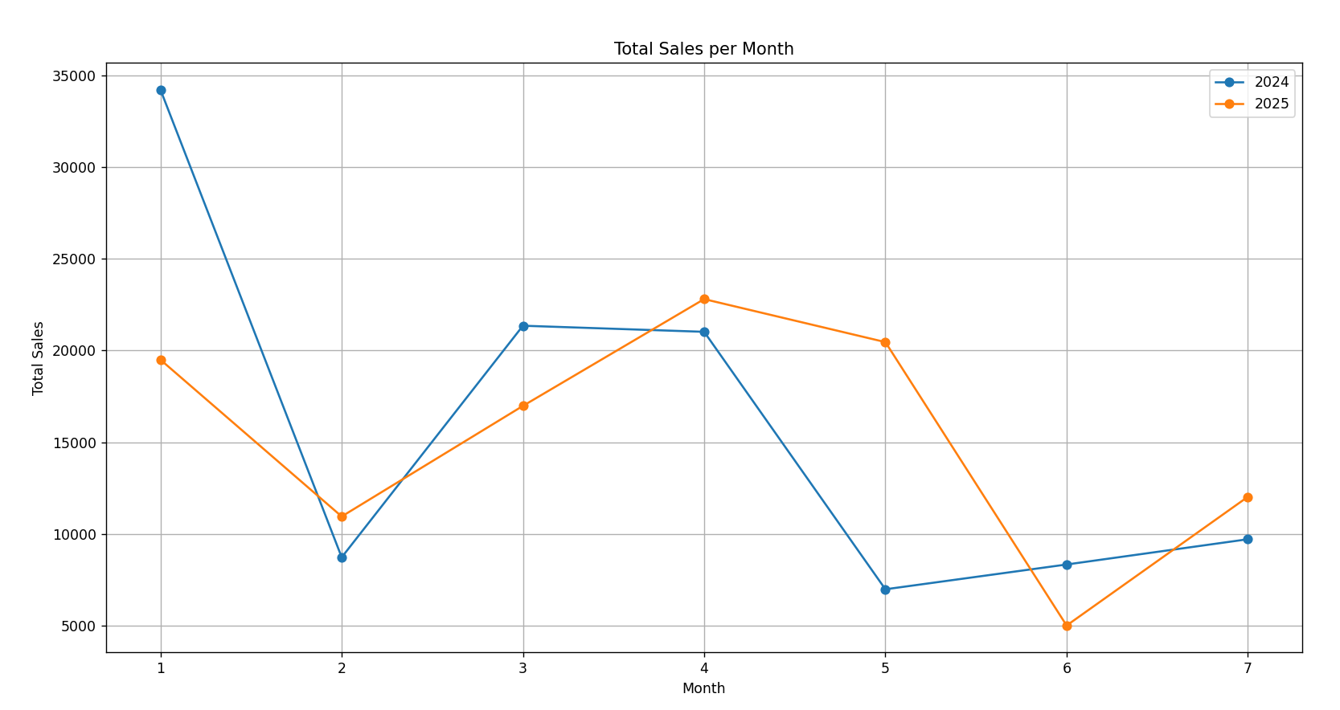
Line Charts
Total Sales per Month: Shows total monthly sales in 2024 and 2025.

Slide 38
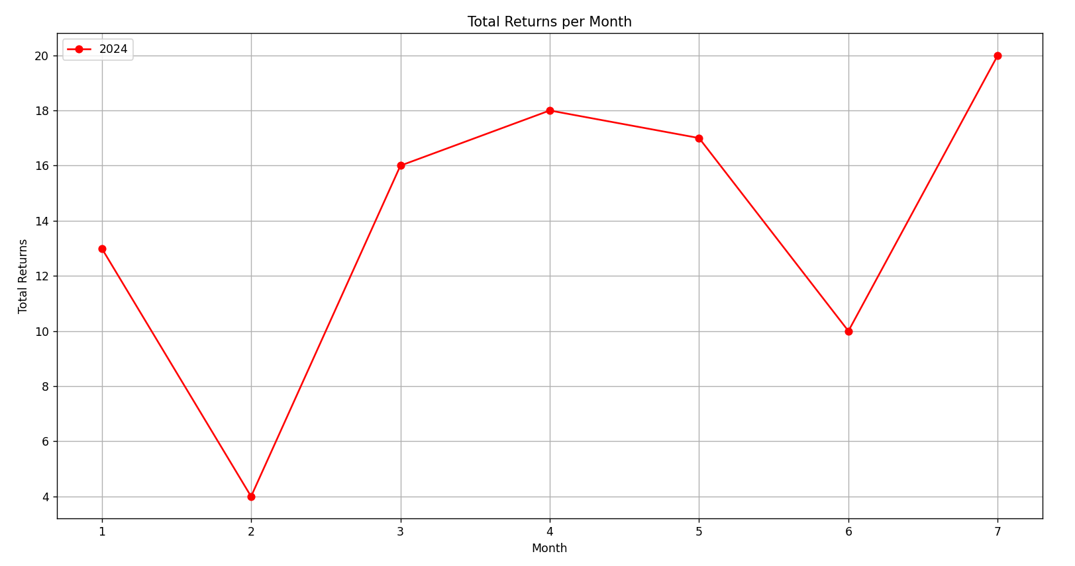
Line Charts
Total Returns per Month: Shows the total monthly returns in 2024.

Slide 39
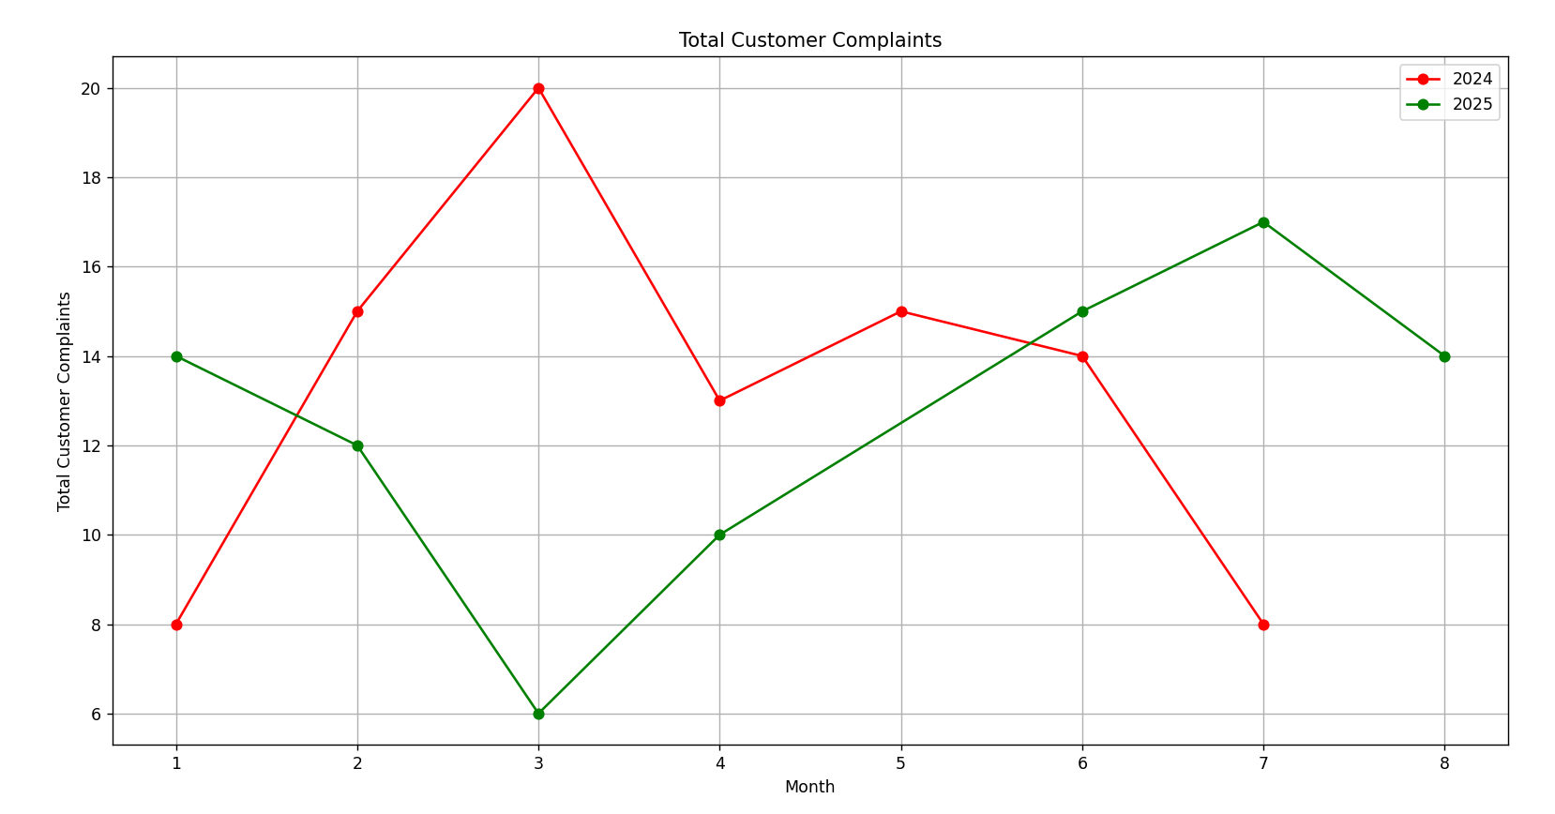
Line Charts
Total Customer Complaints : Shows how many complaints were received monthly in 2024 and 2025.

Slide 40
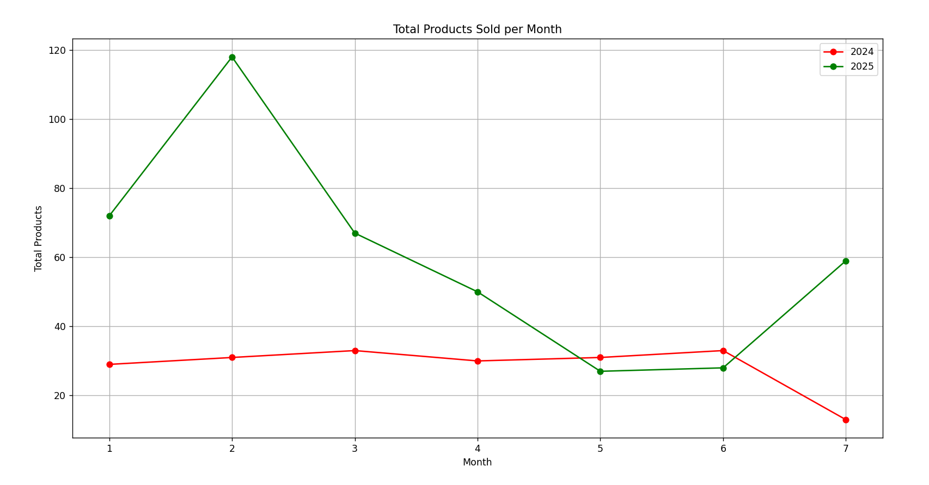
Line Charts
Total Products Sold: Shows total products actually sold monthly in 2024 and 2025.

Slide 41
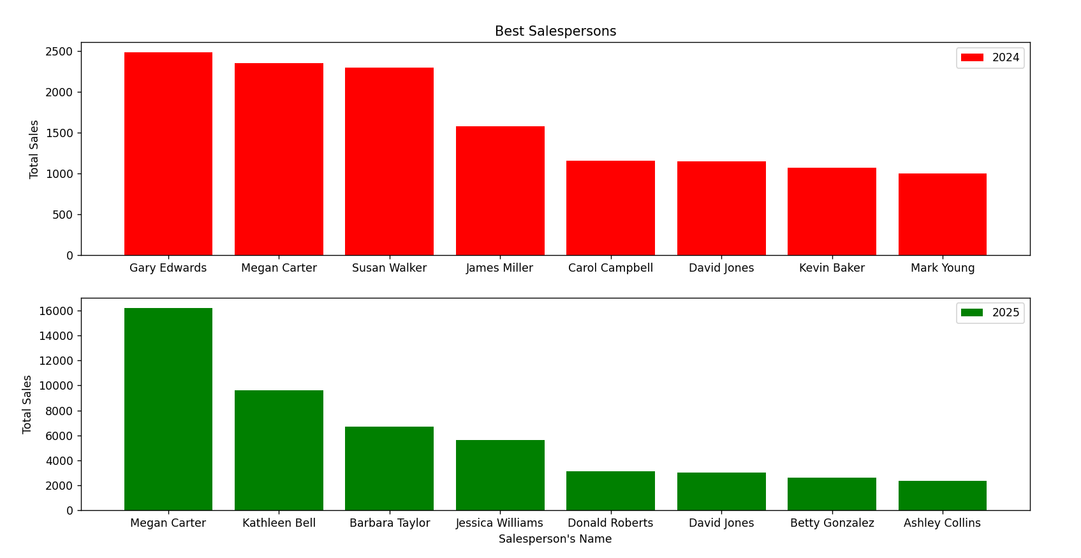
Bar Charts
Best Salespersons: Shows the best salespersons based on the total sales they achieved in 2024 and 2025.

Slide 42
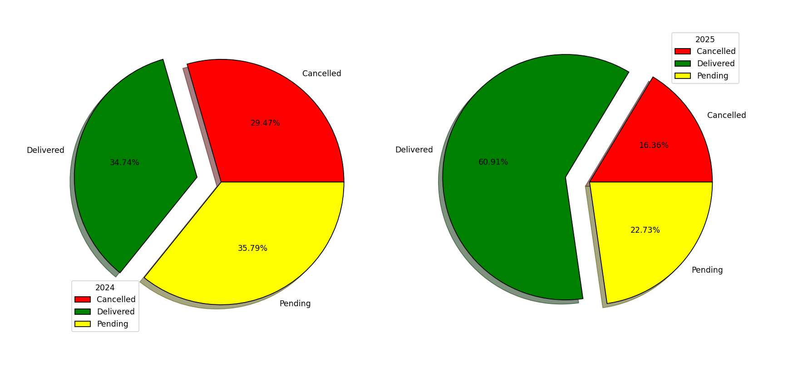
Pie Charts
Percentages of Order Status: Shows Percentages of orders status in 2024 and 2025.

Slide 43
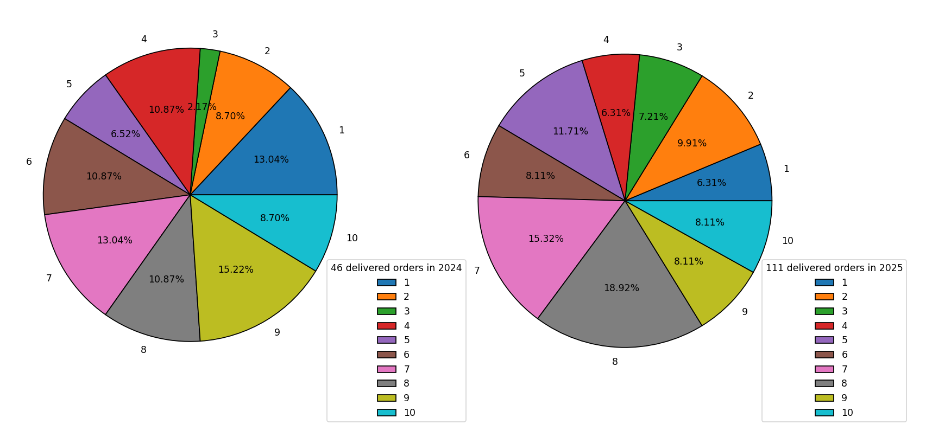
Pie Charts
Percentages of Order Status: Shows Percentages of orders status in 2024 and 2025.

Slide 44
Power BI:
Dashboards.

Slide 45

Dashboards
Sales Dashboard (Orders): Displays the number of orders each month, shows the total due amounts for each day, and defines the number of orders paid using this method (Instapay, credit, wallet, cash).

Slide 46

Dashboards
Sales Dashboard (Products): Displays Rating for each category, shows the number of products per category, defines the quantities of products in each category.

Slide 47

Dashboards
Sales Dashboard (Customers): Displays shipping country, defines the number of customers in each category.

Slide 48
Machine Learning Models

Slide 49

Machine Learning Models
Confusion matrix for support Ticket table: Indicates that the relation between target feature(support status)and other features is weak but it has a kind of relation between the target and support issue feature.

Slide 50

Machine Learning Models
Confusion matrix for orders table: Indicates that there is a strong relationship between order status feature and pay id, payment info features, also indicates that there is a very strong relation between total due and total price feature.

Slide 51

Machine Learning Models
- For the first mode We used Random Forest Classifier on orders Table to predict the order Status(pending,delivered,cancelled).

Slide 52

Machine Learning Models
- The second model we used linear regression on support table to detect the support statuss.

Slide 53

Machine Learning Models
- In The Third Model we used Random forest Classifier on orders table to predict the total due.

Slide 54
The End

